Slide 1
Computer Organization Unit 5
By:
Dr. Gourav Verma
ECE Dept.
GEU

Slide 2
Unit 5
Introduction to Alternative Architectures:
RISC Machines,
Flynn’s Taxonomy,
Parallel and Multiprocessor Architectures: Instruction level pipelining, Superscalar and VLIW,
Vector Processors, Interconnection Networks, Shared Memory Multiprocessors, Closely and Loosely coupled
multiprocessors systems;
Alternative Parallel Processing Approaches:
Dataflow Computing, Neural Networks.

Slide 3
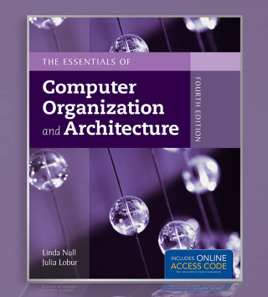
Chapter 9
Reference
Alternative Architectures

Slide 4
Objectives
Learn the properties that often distinguish RISC from CISC architectures.
Understand how multiprocessor architectures are classified.
Appreciate the factors that create complexity in multiprocessor systems.
Become familiar with the ways in which some architectures transcend the traditional von Neumann paradigm.
4

Slide 5
1 Introduction
We have so far studied only the simplest models of computer systems; classical single-processor von Neumann systems.
This chapter presents a number of different approaches to computer organization and architecture.
Some of these approaches are in place in today’s commercial systems. Others may form the basis for the computers of tomorrow.
5
Notes:
5

Slide 6
2. RISC Machines
The underlying philosophy of RISC machines is that a system is better able to manage program execution when the program consists of only a few different instructions that are the same length and require the same number of clock cycles to decode and execute.
RISC systems access memory only with explicit load and store instructions.
In CISC systems, many different kinds of instructions access memory, making instruction length variable and fetch-decode-execute time unpredictable.
6
Notes:
6

Slide 7

2. RISC Machines…
The difference between CISC and RISC becomes evident through the basic computer performance equation:
RISC systems shorten execution time by reducing the clock cycles per instruction.
CISC systems improve performance by reducing the number of instructions per program.
7
Notes:
7

Slide 8
2 RISC Machines
The simple instruction set of RISC machines enables control units to be hardwired for maximum speed.
The more complex-- and variable-- instruction set of CISC machines requires microcode-based control units that interpret instructions as they are fetched from memory. This translation takes time.
With fixed-length instructions, RISC lends itself to pipelining and speculative execution.
8
Notes:
8

Slide 9
2 RISC Machines
Consider the program fragments:
The total clock cycles for the CISC version might be:
(2 movs × 1 cycle) + (1 mul × 30 cycles) = 32 cycles
While the clock cycles for the RISC version is:
(3 movs × 1 cycle) + (5 adds × 1 cycle) + (5 loops × 1 cycle) = 13 cycles
With RISC clock cycle being shorter, RISC gives us much faster execution speeds.
mov ax, 0
mov bx, 10
mov cx, 5
Begin add ax, bx
loop Begin
mov ax, 10
mov bx, 5
mul bx, ax
CISC
RISC
9
Notes:
9

Slide 10
2 RISC Machines
Because of their load-store ISAs, RISC architectures require a large number of CPU registers.
These register provide fast access to data during sequential program execution.
They can also be employed to reduce the overhead typically caused by passing parameters to subprograms.
Instead of pulling parameters of a stack, the subprogram is directed to use a subset of registers.
10
Notes:
10

Slide 11
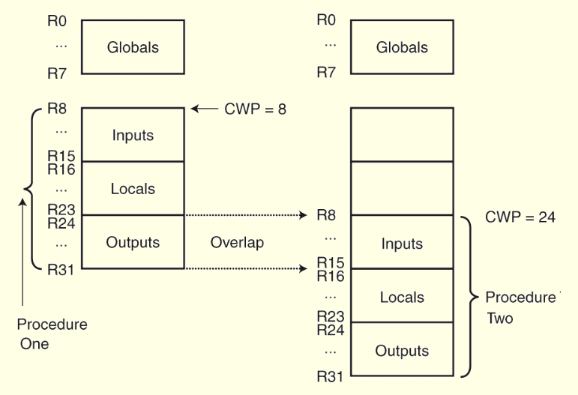
2 RISC Machines
This is how registers can be overlapped in a RISC system.
The current window pointer (CWP) points to the active register window.
11
Notes:
11

Slide 12
2 RISC Machines
It is becoming increasingly difficult to distinguish RISC architectures from CISC architectures.
Some RISC systems provide more extravagant instruction sets than some CISC systems.
Some systems combine both approaches.
The following two slides summarize the characteristics that traditionally typify the differences between these two architectures.
12
Notes:
12

Slide 13
2 RISC Machines
RISC
Multiple register sets.
Three operands per instruction.
Parameter passing through register windows.
Single-cycle instructions.
Hardwired
control.
Highly pipelined.
CISC
Single register set.
One or two register operands per instruction.
Parameter passing through memory.
Multiple cycle instructions.
Microprogrammed control.
Less pipelined.
Continued....
13
Notes:
13

Slide 14
2 RISC Machines
RISC
Simple instructions, few in number.
Fixed length instructions.
Complexity in compiler.
Only LOAD/STORE instructions access memory.
Few addressing modes.
CISC
Many complex instructions.
Variable length instructions.
Complexity in microcode.
Many instructions can access memory.
Many addressing modes.
14
Notes:
14

Slide 15
3 Flynn’s Taxonomy
Many attempts have been made to come up with a way to categorize computer architectures.
Flynn’s Taxonomy has been the most enduring of these, despite having some limitations.
Flynn’s Taxonomy takes into consideration the number of processors and the number of data paths incorporated into an architecture.
A machine can have one or many processors that operate on one or many data streams.
15
Notes:
15

Slide 16
3 Flynn’s Taxonomy
The four combinations of multiple processors and multiple data paths are described by Flynn as:
SISD: Single instruction stream, single data stream. These are classic uniprocessor systems.
SIMD: Single instruction stream, multiple data streams. Execute the same instruction on multiple data values, as in vector processors.
MIMD: Multiple instruction streams, multiple data streams. These are today’s parallel architectures.
MISD: Multiple instruction streams, single data stream.
16
Notes:
16

Slide 17
3 Flynn’s Taxonomy
Flynn’s Taxonomy falls short in a number of ways:
First, there appears to be no need for MISD machines.
Second, parallelism is not homogeneous. This assumption ignores the contribution of specialized processors.
Third, it provides no straightforward way to distinguish architectures of the MIMD category.
One idea is to divide these systems into those that share memory, and those that don’t, as well as whether the interconnections are bus-based or switch-based.
17
Notes:
17

Slide 18
3 Flynn’s Taxonomy
Symmetric multiprocessors (SMP) and massively parallel processors (MPP) are MIMD architectures that differ in how they use memory.
SMP systems share the same memory and MPP do not.
An easy way to distinguish SMP from MPP is:
MPP ⇒ many processors + distributed memory + communication via network
SMP ⇒ fewer processors + shared memory + communication via memory
18
Notes:
18

Slide 19
3 Flynn’s Taxonomy
Other examples of MIMD architectures are found in distributed computing, where processing takes place collaboratively among networked computers.
A network of workstations (NOW) uses otherwise idle systems to solve a problem.
A collection of workstations (COW) is a NOW where one workstation coordinates the actions of the others.
A dedicated cluster parallel computer (DCPC) is a group of workstations brought together to solve a specific problem.
A pile of PCs (POPC) is a cluster of (usually) heterogeneous systems that form a dedicated parallel system.
19
Notes:
19

Slide 20
3 Flynn’s Taxonomy
Flynn’s Taxonomy has been expanded to include SPMD (single program, multiple data) architectures.
Each SPMD processor has its own data set and program memory. Different nodes can execute different instructions within the same program using instructions similar to:
If myNodeNum = 1 do this, else do that
Yet another idea missing from Flynn’s is whether the architecture is instruction driven or data driven.
The next slide provides a revised taxonomy.
20
Notes:
20

Slide 21
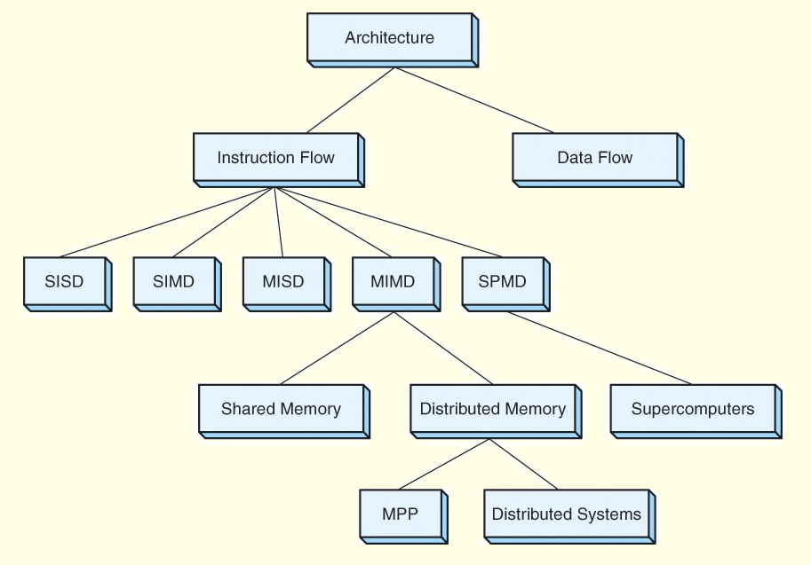
3 Flynn’s Taxonomy
21
Notes:
21

Slide 22
4 Parallel and Multiprocessor Architectures
Parallel processing is capable of economically increasing system throughput while providing better fault tolerance.
The limiting factor is that no matter how well an algorithm is parallelized, there is always some portion that must be done sequentially.
Additional processors sit idle while the sequential work is performed.
Thus, it is important to keep in mind that an n -fold increase in processing power does not necessarily result in an n -fold increase in throughput.
22
Notes:
22

Slide 23
4 Parallel and Multiprocessor Architectures
Recall that pipelining divides the fetch-decode-execute cycle into stages that each carry out a small part of the process on a set of instructions.
Ideally, an instruction exits the pipeline during each tick of the clock.
Superpipelining occurs when a pipeline has stages that require less than half a clock cycle to complete.
The pipeline is equipped with a separate clock running at a frequency that is at least double that of the main system clock.
Superpipelining is only one aspect of superscalar design.
23
Notes:
23

Slide 24
4 Parallel and Multiprocessor Architectures
Superscalar architectures include multiple execution units such as specialized integer and floating-point adders and multipliers.
A critical component of this architecture is the instruction fetch unit, which can simultaneously retrieve several instructions from memory.
A decoding unit determines which of these instructions can be executed in parallel and combines them accordingly.
This architecture also requires compilers that make optimum use of the hardware.
24
Notes:
24

Slide 25
4 Parallel and Multiprocessor Architectures
Very long instruction word (VLIW) architectures differ from superscalar architectures because the VLIW compiler, instead of a hardware decoding unit, packs independent instructions into one long instruction that is sent down the pipeline to the execution units.
One could argue that this is the best approach because the compiler can better identify instruction dependencies.
However, compilers tend to be conservative and cannot have a view of the run time code.
25
Notes:
25

Slide 26
4 Parallel and Multiprocessor Architectures
Vector computers are processors that operate on entire vectors or matrices at once.
These systems are often called supercomputers.
Vector computers are highly pipelined so that arithmetic instructions can be overlapped.
Vector processors can be categorized according to how operands are accessed.
Register-register vector processors require all operands to be in registers.
Memory-memory vector processors allow operands to be sent from memory directly to the arithmetic units.
26
Notes:
26

Slide 27
4 Parallel and Multiprocessor Architectures
A disadvantage of register-register vector computers is that large vectors must be broken into fixed-length segments so they will fit into the register sets.
Memory-memory vector computers have a longer startup time until the pipeline becomes full.
In general, vector machines are efficient because there are fewer instructions to fetch, and corresponding pairs of values can be prefetched because the processor knows it will have a continuous stream of data.
27
Notes:
27

Slide 28
4 Parallel and Multiprocessor Architectures
MIMD systems can communicate through shared memory or through an interconnection network.
Interconnection networks are often classified according to their topology, routing strategy, and switching technique.
Of these, the topology is a major determining factor in the overhead cost of message passing.
Message passing takes time owing to network latency and incurs overhead in the processors.
28
Notes:
28

Slide 29
4 Parallel and Multiprocessor Architectures
Interconnection networks can be either static or dynamic.
Processor-to-memory connections usually employ dynamic interconnections. These can be blocking or nonblocking.
Nonblocking interconnections allow connections to occur simultaneously.
Processor-to-processor message-passing interconnections are usually static, and can employ any of several different topologies, as shown on the following slide.
29
Notes:
29

Slide 30
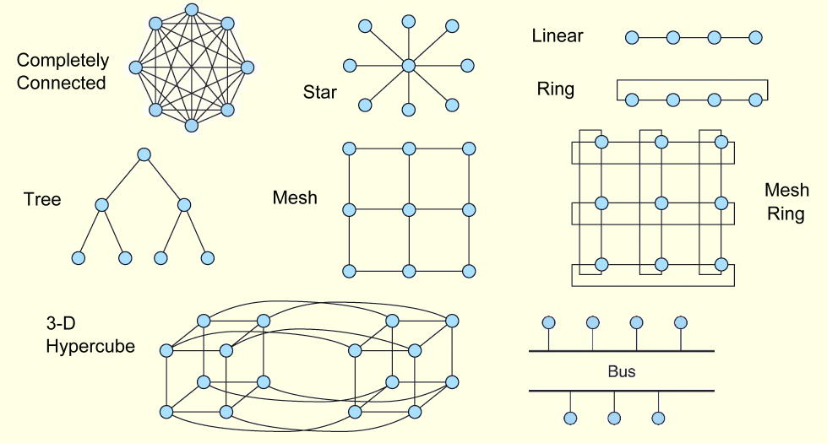
4 Parallel and Multiprocessor Architectures
30
Notes:
30

Slide 31
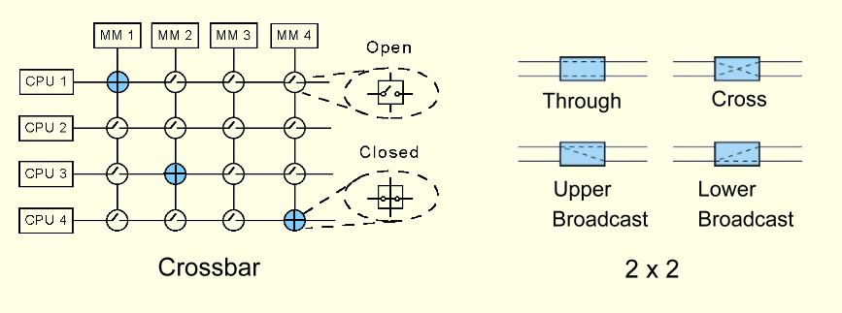
4 Parallel and Multiprocessor Architectures
Dynamic routing is achieved through switching networks that consist of crossbar switches or 2 × 2 switches.
31
Notes:
31

Slide 32
4 Parallel and Multiprocessor Architectures
There are advantages and disadvantages to each switching approach.
Bus-based networks, while economical, can be bottlenecks. Parallel buses can alleviate bottlenecks, but are costly.
Crossbar networks are nonblocking, but require n² switches to connect n entities.
Omega networks are blocking networks, but exhibit less contention than bus-based networks. They are somewhat more economical than crossbar networks, n nodes needing log₂n stages with n / 2 switches per stage.
32
Notes:
32

Slide 33
4 Parallel and Multiprocessor Architectures
Tightly-coupled multiprocessor systems use the same memory. They are also referred to as shared memory multiprocessors.
The processors do not necessarily have to share the same block of physical memory:
Each processor can have its own memory, but it must share it with the other processors.
Configurations such as these are called distributed shared memory multiprocessors.
33
Notes:
33

Slide 34
4 Parallel and Multiprocessor Architectures
Shared memory MIMD machines can be divided into two categories based upon how they access memory.
In uniform memory access (UMA) systems, all memory accesses take the same amount of time.
To realize the advantages of a multiprocessor system, the interconnection network must be fast enough to support multiple concurrent accesses to memory, or it will slow down the whole system.
Thus, the interconnection network limits the number of processors in a UMA system.
34
Notes:
34

Slide 35
4 Parallel and Multiprocessor Architectures
The other category of MIMD machines are the nonuniform memory access (NUMA) systems.
While NUMA machines see memory as one contiguous addressable space, each processor gets its own piece of it.
Thus, a processor can access its own memory much more quickly than it can access memory that is elsewhere.
Not only does each processor have its own memory, it also has its own cache, a configuration that can lead to cache coherence problems.
35
Notes:
35

Slide 36
4 Parallel and Multiprocessor Architectures
When a processor’s cached value is updated concurrently with the update to memory, we say that the system uses a write-through cache update protocol.
If the write-through with update protocol is used, a message containing the update is broadcast to all processors so that they may update their caches.
If the write-through with invalidate protocol is used, a broadcast asks all processors to invalidate the stale cached value.
36
Notes:
36

Slide 37
4 Parallel and Multiprocessor Architectures
Write-invalidate uses less bandwidth because it uses the network only the first time the data is updated, but retrieval of the fresh data takes longer.
Write-update creates more message traffic, but all caches are kept current.
Another approach is the write-back protocol that delays an update to memory until the modified cache block must be replaced.
At replacement time, the processor writing the cached value must obtain exclusive rights to the data. When rights are granted, all other cached copies are invalidated.
37
Notes:
37

Slide 38
4 Parallel and Multiprocessor Architectures
Distributed computing is another form of multiprocessing. However, the term distributed computing means different things to different people.
In a sense, all multiprocessor systems are distributed systems because the processing load is distributed among processors that work collaboratively.
The common understanding is that a distributed system consists of very loosely-coupled processing units.
Recently, NOWs have been used as distributed systems to solve large, intractable problems.
38
Notes:
38

Slide 39
4 Parallel and Multiprocessor Architectures
For general-use computing, the details of the network and the nature of the multiplatform computing should be transparent to the users of the system.
Remote procedure calls (RPCs) enable this transparency. RPCs use resources on remote machines by invoking procedures that reside and are executed on the remote machines.
RPCs are employed by numerous vendors of distributed computing architectures including the Common Object Request Broker Architecture (CORBA) and Java’s Remote Method Invocation (RMI).
39
Notes:
39

Slide 40
4 Parallel and Multiprocessor Architectures
Cloud computing is distributed computing to the extreme.
It provides services over the Internet through a collection of loosely-coupled systems.
In theory, the service consumer has no awareness of the hardware, or even its location.
Your services and data may even be located on the same physical system as that of your business competitor.
The hardware might even be located in another country.
Security concerns are a major inhibiting factor for cloud computing.
40
Notes:
40

Slide 41
5 Alternative Parallel Processing Approaches
Some people argue that real breakthroughs in computational power-- breakthroughs that will enable us to solve today’s intractable problems-- will occur only by abandoning the von Neumann model.
Numerous efforts are now underway to devise systems that could change the way that we think about computers and computation.
In this section, we will look at three of these: dataflow computing, neural networks, and systolic processing.
41
Notes:
41

Slide 42
5 Alternative Parallel Processing Approaches
Von Neumann machines exhibit sequential control flow: A linear stream of instructions is fetched from memory, and they act upon data.
Program flow changes under the direction of branching instructions.
In dataflow computing, program control is directly controlled by data dependencies.
There is no program counter or shared storage.
Data flows continuously and is available to multiple instructions simultaneously.
42
Notes:
42

Slide 43
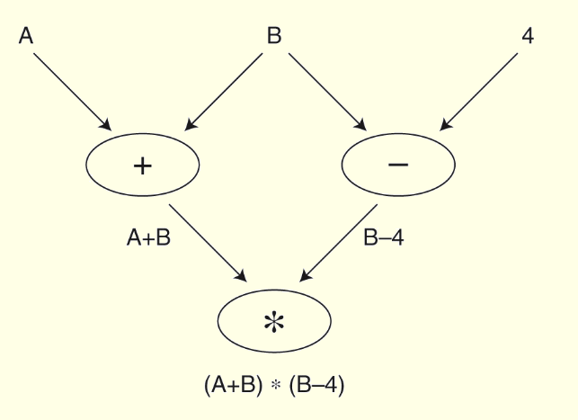
5 Alternative Parallel Processing Approaches
A data flow graph represents the computation flow in a dataflow computer.
Its nodes contain the instructions and its arcs indicate the data dependencies.
43
Notes:
43

Slide 44
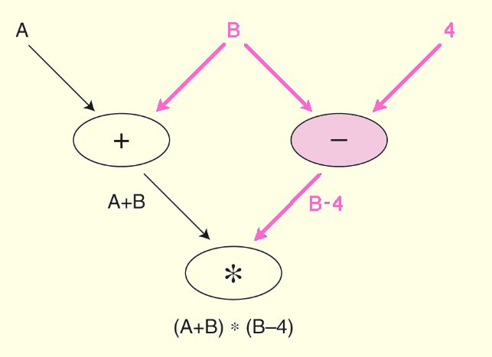
5 Alternative Parallel Processing Approaches
When a node has all of the data tokens it needs, it fires, performing the required operation, and consuming the token.
The result is placed on an output arc.
44
Notes:
44

Slide 45
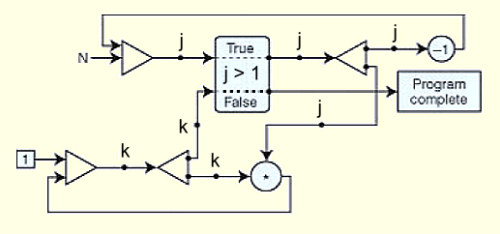
5 Alternative Parallel Processing Approaches
A dataflow program to calculate n! and its corresponding graph are shown below.
(initial j <- n; k <- 1
while j > 1 do
new k<- * j;
new j <- j - 1;
return k)
45
Notes:
45

Slide 46
5 Alternative Parallel Processing Approaches
The architecture of a dataflow computer consists of processing elements that communicate with one another.
Each processing element has an enabling unit that sequentially accepts tokens and stores them in memory.
If the node to which this token is addressed fires, the input tokens are extracted from memory and are combined with the node itself to form an executable packet.
46
Notes:
46

Slide 47
5 Alternative Parallel Processing Approaches
Using the executable packet, the processing element’s functional unit computes any output values and combines them with destination addresses to form more tokens.
The tokens are then sent back to the enabling unit, optionally enabling other nodes.
Because dataflow machines are data driven, multiprocessor dataflow architectures are not subject to the cache coherency and contention problems that plague other multiprocessor systems.
47
Notes:
47

Slide 48
5 Alternative Parallel Processing Approaches
Neural network computers consist of a large number of simple processing elements that individually solve a small piece of a much larger problem.
They are particularly useful in dynamic situations that are an accumulation of previous behavior, and where an exact algorithmic solution cannot be formulated.
Like their biological analogues, neural networks can deal with imprecise, probabilistic information, and allow for adaptive interactions.
48
Notes:
48

Slide 49
5 Alternative Parallel Processing Approaches
Neural network processing elements (PEs) multiply a set of input values by an adaptable set of weights to yield a single output value.
The computation carried out by each PE is simplistic-- almost trivial-- when compared to a traditional microprocessor. Their power lies in their massively parallel architecture and their ability to adapt to the dynamics of the problem space.
Neural networks learn from their environments. A built-in learning algorithm directs this process.
49
Notes:
49

Slide 50
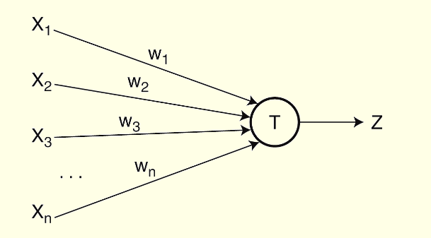
5 Alternative Parallel Processing Approaches
The simplest neural net PE is the perceptron.
Perceptrons are trainable neurons. A perceptron produces a Boolean output based upon the values that it receives from several inputs.
50
Notes:
50

Slide 51
5 Alternative Parallel Processing Approaches
Perceptrons are trainable because the threshold and input weights are modifiable.
In this example, the output Z is true (1) if the net input, w₁x₁ + w₂x₂ + . . .+ w_{n}x_{n} is greater than the threshold T.
51
Notes:
51

Slide 52
5 Alternative Parallel Processing Approaches
Perceptrons are trained by use of supervised or unsupervised learning.
Supervised learning assumes prior knowledge of correct results which are fed to the neural net during the training phase. If the output is incorrect, the network modifies the input weights to produce correct results.
Unsupervised learning does not provide correct results during training. The network adapts solely in response to inputs, learning to recognize patterns and structure in the input sets.
52
Notes:
52

Slide 53
5 Alternative Parallel Processing Approaches
The biggest problem with neural nets is that when they consist of more than 10 or 20 neurons, it is impossible to understand how the net is arriving at its results. They can derive meaning from data that are too complex to be analyzed by people.
The U.S. military once used a neural net to try to locate camouflaged tanks in a series of photographs. It turned out that the nets were basing their decisions on the cloud cover instead of the presence or absence of the tanks.
Despite early setbacks, neural nets are gaining credibility in sales forecasting, data validation, and facial recognition.
53
Notes:
53

Slide 54
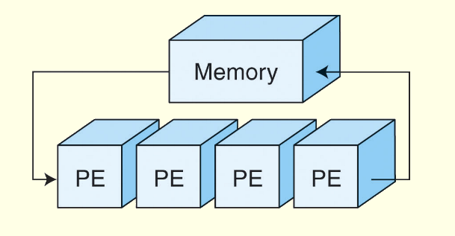
5 Alternative Parallel Processing Approaches
Where neural nets are a model of biological neurons, systolic array computers are a model of how blood flows through a biological heart.
•
Systolic arrays, a variation of SIMD computers, have simple processors that process data by circulating it through vector pipelines.
54
Notes:
54

